Slide 2
In this A-level Psychology Video – Paper 1 – Memory 5) Factors affecting the accuracy of eyewitness testimony
What the AQA A-level specification says…
Factors affecting the accuracy of eyewitness testimony: misleading information, including leading questions and post-event discussion; anxiety

Slide 3
Memory – Eyewitness testimony: Misleading information – A01
Bartlett (1932) Argued that memories are not accurate ‘snapshots’ of events perfectly preserved, but are instead ‘reconstructions’ of events. These reconstructions are influenced by our personal attitudes and the stereotypes we hold.
But if recall is not objective then this is a problem for EWT
Schema: Packages of information about people and objects in the world around us. We use schema as mental shortcuts. Because when we recall a memory it is influenced by schemas, memories change to fit with the individuals pre-existing bias.
Reconstructive memory: Memory is not an accurate recording of events. It is reconstructed in recalling and may produce errors (confabulations)
leading questions, questions that imply a particular answer can influence how a memory is recalled. This could be due to an actual change to the memory (Substitution bias explanation) or not to a change in memory, but due to an emotional pressure to give a particular response (response bias explanation)
Post-event contamination/discussion: is when the recalling of events by one witness alters the accuracy of the recall by another witness. This could be memory conformity, the witnesses go along with others accounts for social approval

Slide 4
Memory – Improving the accuracy of eyewitness testimony – A03
EV / A03
Loftus and Palmer(1974) Participants N=45 were shown clips of traffic accidents. After watching the clip they where asked the following critical (leading) question “how fast were the cars going when they ___ into each other. The missing verb was changed (to smashed, collided, bumped, hit or contacted. It was found the more extreme the verb the faster the estimation of MPH. Contacted = 31.8 and smashed = 40.8. This suggests misleading information in the form of leading questions can influence the recall of eyewitness testimony
EV / A03
Loftus and Palmer(1974) In a follow up study, participants N = 150, were shown a car accident clip without broken glass. After viewing they were asked how fast the cars were going including either verb “hit” or “smashed” or a control group. After one week participants completed a questionnaire. “did you see broken glass?” was one of the questions. It was found participants were twice as likely in smashed condition to respond yes compared to the hit condition This suggests The effects of misleading information in the form of leading questions can be long lasting and actually changes memories via substitution, rather than response bias.

Slide 5
Memory – Improving the accuracy of eyewitness testimony – A03
EV / A03
Gabbert et al (2003) Videos of crimes shot from different perspectives were shown to pairs of participants. With unique information available in each film. It was found 71% of pairs allowed to discuss what they had seen included aspects of the film they had not seen in their recollection of the video. This is compared to 0% in pairs who were not allowed to discuss what they had seen. This suggests That witnesses will change their account of crimes to match other witnesses testimony. This may be an attempt to seek social approval, resulting in memory conformity.
EV / A03
Bodner et al (2009) in an experimental setup similar to Gabbert participants where explicitly discouraged from sharing information in their testimony. It was found that these participants shared significantly less information gained from the other witness. This suggests that if warned about the dangers of Post-event discussion its effects can be reduced.

Slide 6
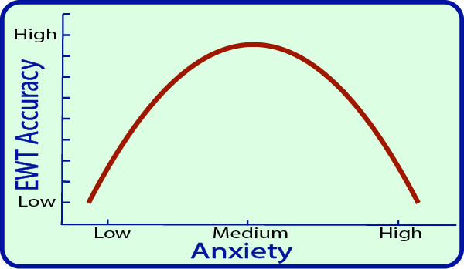
Memory – Eyewitness testimony: Anxiety – A01
Anxiety: is a mental state of arousal that includes feelings of extreme concern and tension. This often accompanied by physiological changes such increased heartrate
ETW: In real life EWT is often used after violent crimes causing high anxiety. Research in EWT often has no emotional impact on the participant, resulting in low validity
Decreases Recall: high levels of anxiety produce reduced recall of the criminals face. Weapon effect/focus is one explanation, weapons are a cause of anxiety, witnesses are distracted, focusing attention on the weapon rather than the criminal.
Increases Recall: a state of arousal improves alertness, and awareness of the situation and surroundings. Also the strong emotions felt could improve memory encoding
Yerks-Dodson Law of arousal: EWT accuracy increases as anxiety raises as the witness becomes alert. However at a point anxiety becomes too high and more stress/ distraction results in lower accuracy.

Slide 7
Memory – Improving the accuracy of eyewitness testimony – A03
EV / A03
Johnson and Scott (1976) naive participants were placed outside a lab, listening to conversations. 1) normal conversation about equipment failure, man walks out with greasy hands and a pen. or 2) Hostile, breaking glass, furniture knocked over. Man walks out with knife covered in blood. then asked to identify the man from 50 photographs coming out of lab. It was found more participants identified a man with a pen (49%) than knife (33%). This suggests Anxiety is caused by knife, resulting in decreased focus on the mans face and more on the weapon.
EV / A03
Peters (1988) Patients at a real healthcare centre were given a real injection by a nurse, with a researcher also present in the room. It was found that the patients were better able to recognise the researcher than the nurse This suggests Anxiety is caused by having an injection, and there is weapon focus on the syringe.
EV / A03
Yuille and Cutshall (1986) Interviewed 13 witness to a deadly shooting four months after the event. It was found witnesses resisted misleading information and those with the most stress (closest to the shooter) produced the most accurate ETW. This suggests misleading information and anxiety may not be a significant problem for real world eye witness testimony.

Slide 8
Memory – Eyewitness testimony – Additional Evaluations – A03
EV / A03
Research on the limitations of EWT has led to real-life applications. One example is the development of the cognitive interview. This technique is designed to reduce the influence of schemas on the accuracy of recall.
EV / A03
Experimental designs such Loftus’s using films of staged crashes and crimes are conducted in a laboratory setting rather than a court room. This means that participants are aware there is a lack of consequences for providing inaccurate EWT. It could be that in the real world under oath people provide more accurate EWT when what they say could lead to a conviction.
EV / A03
Lab based studies can suffer from demand characteristics with participants often wanting to “help” the researcher by giving responses they expect. In the case of researching leading questions, the participant may just be picking up on the language used and giving an answer they think will help the researcher (response bias explanation)
EV / A03
Researchers have an ethical duty to protect their participants from harm, and to ask for informed consent. Research on anxiety such as Johnson and Scott breaks both of these guidelines and could be considered unethical. Even interviewing people about traumatic experiences could cause additional anxiety.

Slide 9
Memory – factors affecting EWT - REAL EXAM QUESTIONS
Year: 2017 | Paper: 1 | Qualification: AL | Q:10 | MARKS: 16
Outline and evaluate research (theories and/or studies) into the effects of misleading information on eyewitness testimony.
Neurone patrons and above can watch a tutorial on how to respond to this on psychboost.com

